Slide 1



Choose the most attractive couple

Slide 2
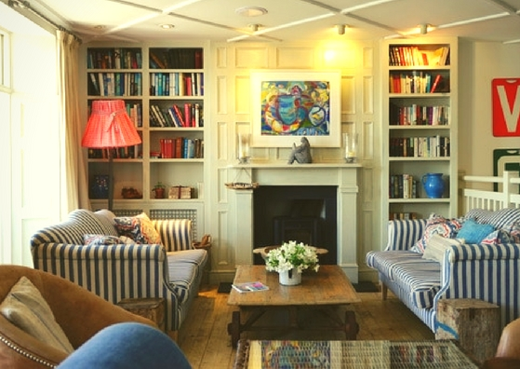
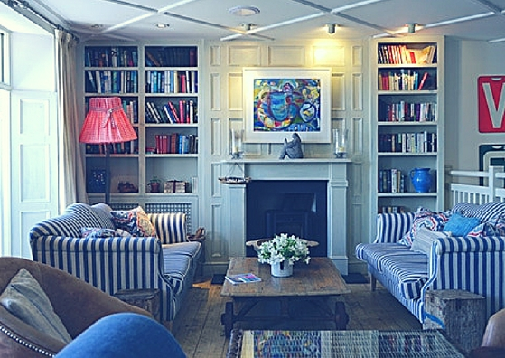
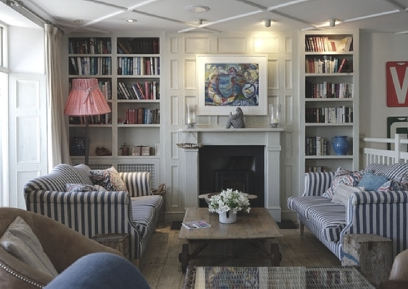
Choose the coziest room

Slide 3
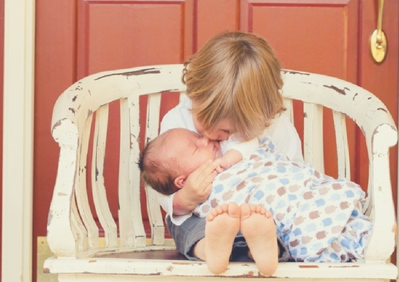
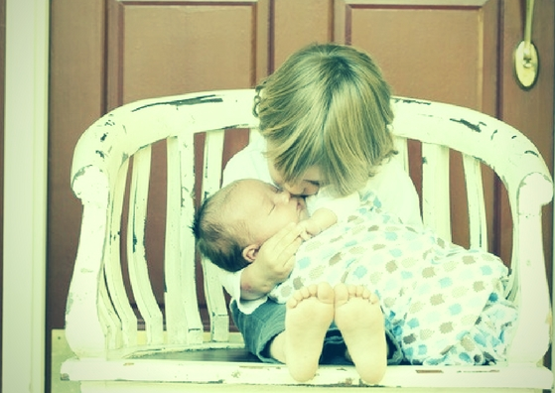
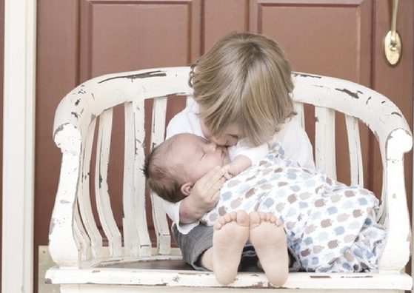
Choose the most touching scene

Slide 4
The area where you live
Think about your neighbourhood.
What are the three main colours you recall right now?
Colour 1:
Colour 2:
Colour 3:
How do these colours make you feel?

Slide 5
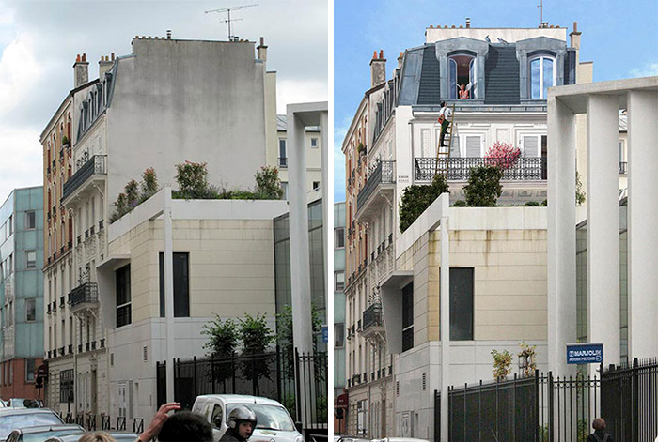
Does it look familiar?

Slide 6
Transforming the landscape
See what happens when
a French street artist, Patrick Commecy,
meets a building facade.

Slide 7
Choose your words wisely
Here is one of the headlines:
Artist transforms drab buildings with stunning 3D optical illusion murals resembling vibrant street scenes.
Think of at least 2 more words to use instead of these in bold.

Slide 8
Know your tools
Where can you look for synonyms?
www.wordhippo.com

Slide 9


Slide 10
Choose your words wisely
DRAB
STUNNING
VIBRANT

Slide 11
Language: Adjectives
Which of the adjectives you chose are gradable and which are non-gradable? Fill in the table.
GRADABLE | NON-GRADABLE

Slide 12
Language: Adjectives
How can we modify the meaning of an adjective?
ADVERBS

Slide 13
Language: Adverbs
Here are the most common modifying adverbs:
absolutely completely
extremely very
quite really

Slide 14
Language: Modifying adjectives
Choose the correct option in each sentence
The view from my window is absolutely / very stunning.
The neighbours are absolutely / quite nice in this area.
I am absolutely / really thrilled to live here.
I wouldn’t change anything about this place, it’s absolutely / very perfect.
My only complaint is the rent, it is completely / quite high.
The idea of building a car park here is completely / very idiotic!

Slide 15
Language: Modifying adjectives
very extremely quite really | absolutely completely really
gradable
non-gradable

Slide 16
Know your tools
Where can you look for collocations & word sketches?
http://skell.sketchengine.co.uk/

Slide 17


Slide 18
Before and after
Source: http://www.boredpanda.com/street-art-realistic-fake-facades-patrick-commecy/

Slide 19
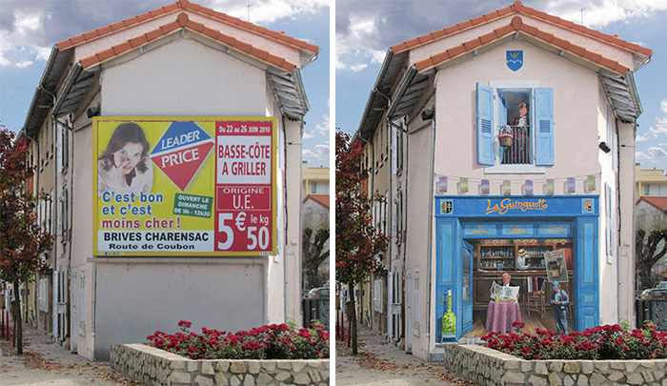
Before and after
Source: http://www.boredpanda.com/street-art-realistic-fake-facades-patrick-commecy/

Slide 20
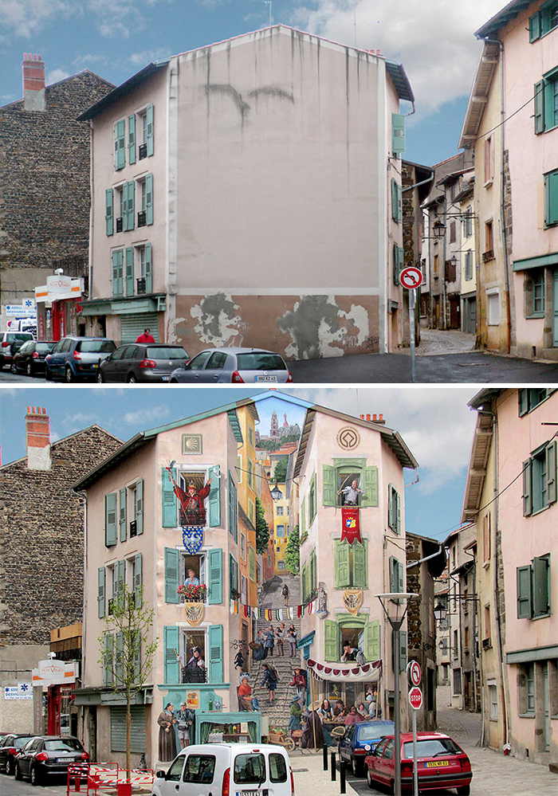
Before and after
Source: http://www.boredpanda.com/street-art-realistic-fake-facades-patrick-commecy/

Slide 21
Initiating change / Resisting change
You want to petition the town hall and get the funding to hire Patrick Commecy to transform your sad-looking neighbourhood. First, you need to collect 100 signatures from your neighbours. How would you persuade them to back your idea?
Your annoying neighbour is trying to get a French artist to paint some silliness on the building walls in the neighbourhood. You think it is absolutely unnecessary and the town hall could invest in some other project. Persuade the neighbours not to sign the “Mural Petition”.

Slide 22
Homework
Your local council has decided to spend part of its budget on improving the way your area looks.
Outline the possible changes that could make the neighbourhood more visually appealing and suggest the best allocation of funds.
Write your proposal.

